Slide 1
PRESENTATION OUTLINE:
  PROJECT BACKGROUND
  ANALYSIS #1: Energy Analysis
  ANALYSIS #2: Photovoltaic Array
  ANALYSIS #3: Structural Modification
  ANALYSIS #4: Bathroom Prefabrication
  LESSONS LEARNED
  ACKNOWLEDGEMENTS
WEST FUALA PLANT EXPANSION
BREADTH TOPICS
  RENEWABLE ENERGY/ELECTRICAL BREADTH
  STRUCTURAL IMPACT ANALYSIS
JAAFAR AL AIDAROOS | CONSTRUCTION MANAGEMENT
PENN STATE AE SENIOR CAPSTONE PROJECT
ADVISOR: DR. CHIMAY ANUMBA

Slide 2
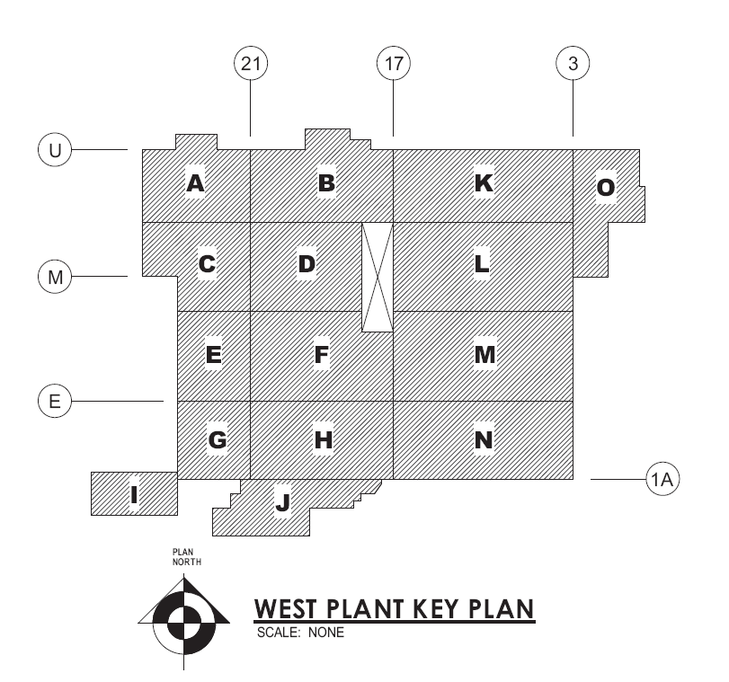
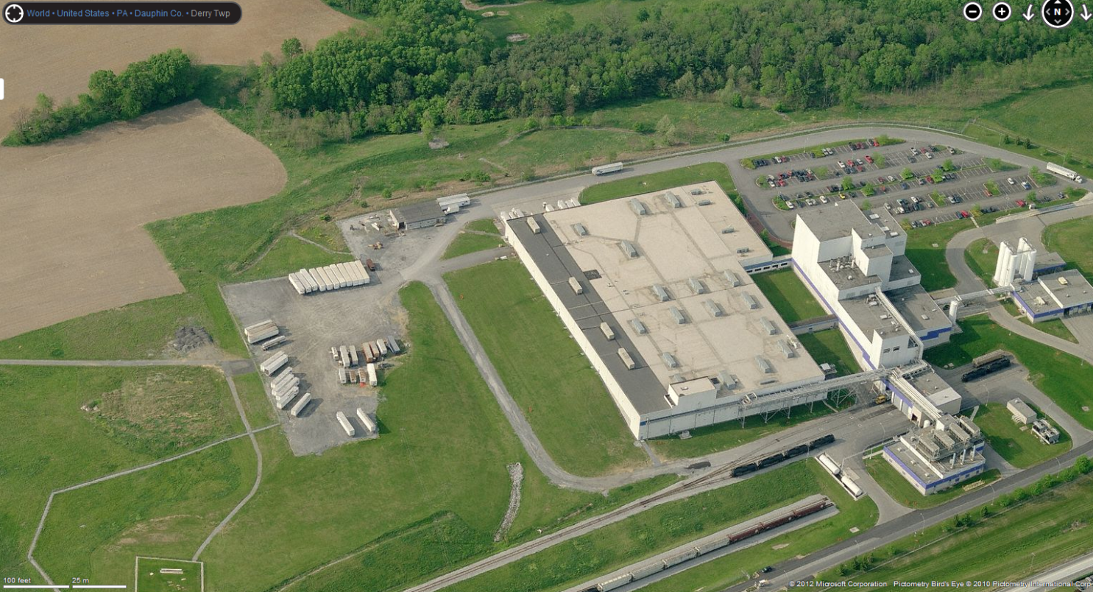
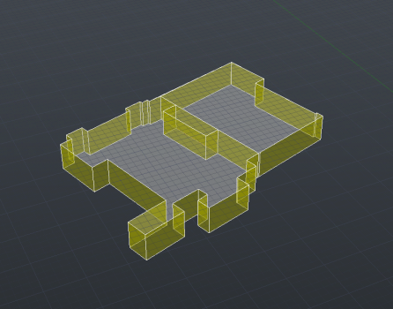
WEST FUALA PLANT EXPANSION
PROJECT BACKGROUND
JAAFAR AL AIDAROOS | CONSTRUCTION MANAGEMENT
PENN STATE AE SENIOR CAPSTONE PROJECT
ADVISOR: DR. CHIMAY ANUMBA
PRESENTATION OUTLINE:
  PROJECT BACKGROUND
  ANALYSIS #1: Energy Analysis
  ANALYSIS #2: Photovoltaic Array
  ANALYSIS #3: Structural Modification
  ANALYSIS #4: Bathroom Prefabrication
  LESSONS LEARNED
  ACKNOWLEDGEMENTS
Building Name: Confidential – West Fuala Expansion
Location: Confidential – Harrisburg, PA
Gross Building Area: 350,545 SF
Number of Stories: ½ Basement + First floor + Mezzanine
Building Type: Food processing and packaging plant
Contractor: Turner Construction Company
Project Delivery Method: Design-Bid-Build
GMP contract: $83 Million
Construction Dates: June 2010 – February 2012
West Expansion
Plant before the expansion

Slide 3
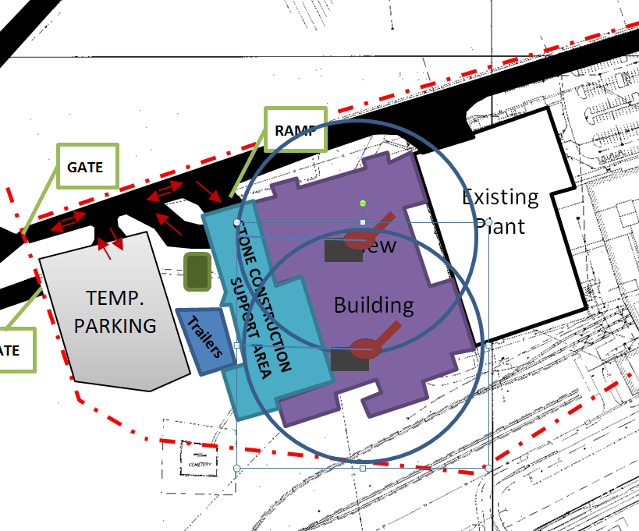
WEST FUALA PLANT EXPANSION
PROJECT BACKGROUND
JAAFAR AL AIDAROOS | CONSTRUCTION MANAGEMENT
PENN STATE AE SENIOR CAPSTONE PROJECT
ADVISOR: DR. CHIMAY ANUMBA
PRESENTATION OUTLINE:
  PROJECT BACKGROUND
  ANALYSIS #1: Energy Analysis
  ANALYSIS #2: Photovoltaic Array
  ANALYSIS #3: Structural Modification
  ANALYSIS #4: Bathroom Prefabrication
  LESSONS LEARNED
  ACKNOWLEDGEMENTS
Structural System
First Floor: Precast concrete
Mezzanine: Steel
Area O: CMU walls
Construction Phases
Mobilization
Sitework
Foundation
Erection of Envelope
Building Water-tight
  and fitouts
Lighting System
650 Volt-Amperes
West Expansion
Erection of Envelope Phase

Slide 4
WEST FUALA PLANT EXPANSION
PROJECT BACKGROUND
JAAFAR AL AIDAROOS | CONSTRUCTION MANAGEMENT
PENN STATE AE SENIOR CAPSTONE PROJECT
ADVISOR: DR. CHIMAY ANUMBA
PRESENTATION OUTLINE:
  PROJECT BACKGROUND
  ANALYSIS #1: Energy Analysis
  ANALYSIS #2: Photovoltaic Array
  ANALYSIS #3: Structural Modification
  ANALYSIS #4: Bathroom Prefabrication
  LESSONS LEARNED
  ACKNOWLEDGEMENTS
Issue
100 Years
Energy issue - High energy demand
Many Structural trades
Congestion in Area O
Thesis Proposal
Energy Analysis
Photovoltaic Panels
Breadth
Structure modification to Precast Concrete Mezzanine
Breadth
Precast Prefabrication of Bathroom walls in Area O
Type of Analysis
Promote a better long term sustainable design
Generate Sustainable Energy
Modify Structure
Utilizing prefabrication to reduce congestions

Slide 5


WEST FUALA PLANT EXPANSION
ENERGY ANALYSIS
JAAFAR AL AIDAROOS | CONSTRUCTION MANAGEMENT
PENN STATE AE SENIOR CAPSTONE PROJECT
ADVISOR: DR. CHIMAY ANUMBA
PRESENTATION OUTLINE:
  PROJECT BACKGROUND
  ANALYSIS #1: Energy Analysis
    Information
    Energy Model
    Solar Analysis
      Solar Studies
      Ecotect Solar Radiation
      Propose Solar Design Change
      Effect on Energy model
    Recommendations
  ANALYSIS #2: Photovoltaic Array
  ANALYSIS #3: Structural Modification
  ANALYSIS #4: Bathroom Prefabrication
  LESSONS LEARNED
  ACKNOWLEDGEMENTS
Tools
  AutoDesk - Project Vasari
  BIM Model
Energy model
Create or import building model
Import parameters
Run Energy model Analysis
Analyze BIM model
Parameters:
  Manufacturing
  Harrisburg, PA
  24/7 facility
  One HVAC system
Energy Analysis
Produces an Energy model
Used throughout design stage to assess the effect of design changes on the energy usage

Slide 6
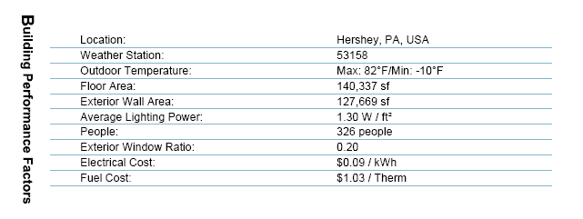
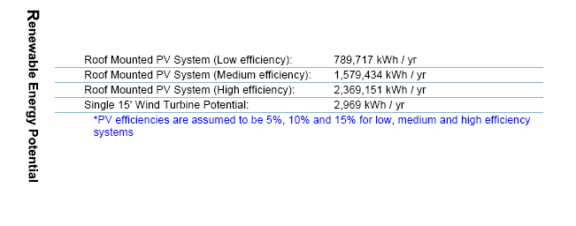
WEST FUALA PLANT EXPANSION
ENERGY ANALYSIS
JAAFAR AL AIDAROOS | CONSTRUCTION MANAGEMENT
PENN STATE AE SENIOR CAPSTONE PROJECT
ADVISOR: DR. CHIMAY ANUMBA
PRESENTATION OUTLINE:
  PROJECT BACKGROUND
  ANALYSIS #1: Energy Analysis
    Information
    Energy Model
    Solar Analysis
      Solar Studies
      Ecotect Solar Radiation
      Propose Solar Design Change
      Effect on Energy model
    Recommendations
  ANALYSIS #2: Photovoltaic Array
  ANALYSIS #3: Structural Modification
  ANALYSIS #4: Bathroom Prefabrication
  LESSONS LEARNED
  ACKNOWLEDGEMENTS
BIM - Energy Analysis
Energy model
Information produced:
Building performance Factor
Energy Use intensity
Life Cycle Energy Use
Renewable Energy Potential
Emissions
Annual Energy Use
Et cetera
Energy Model Report

Slide 7
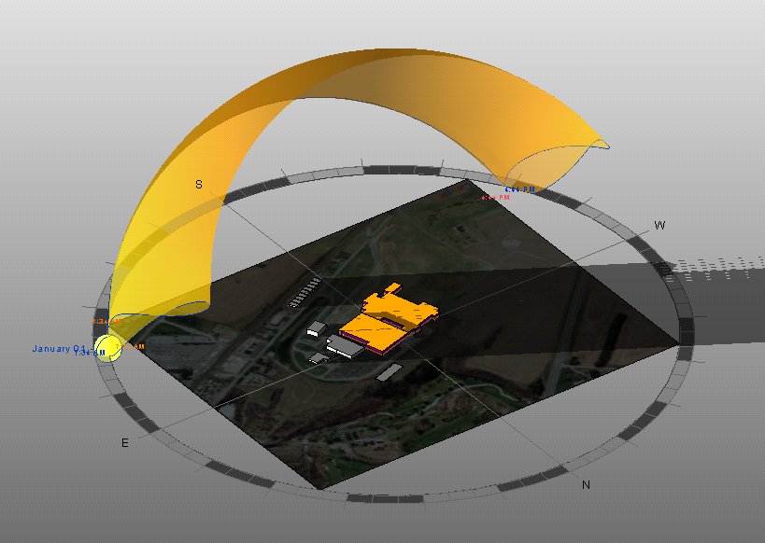
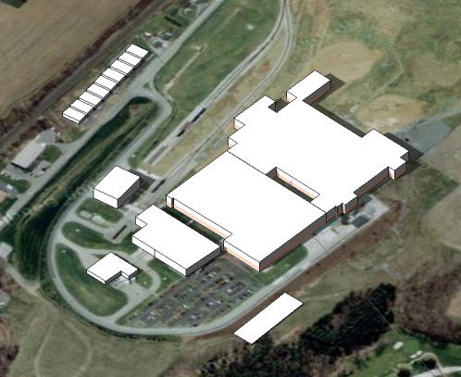
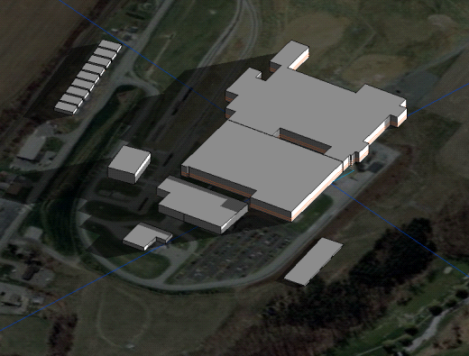
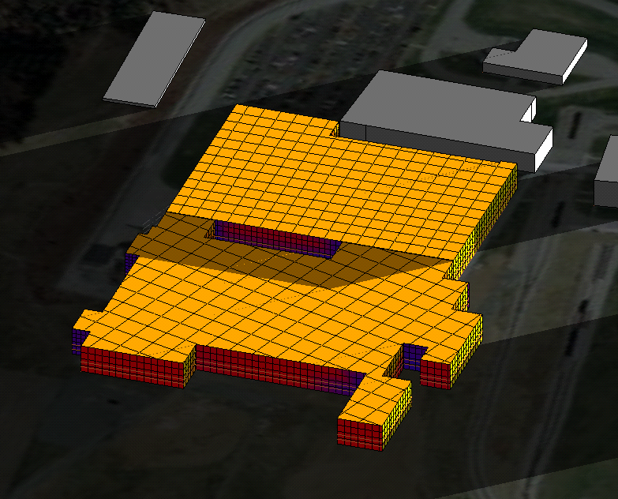
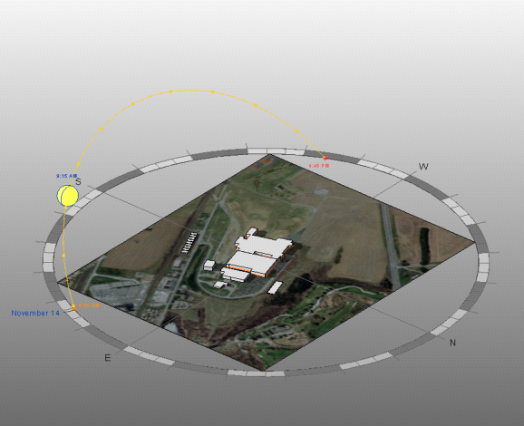
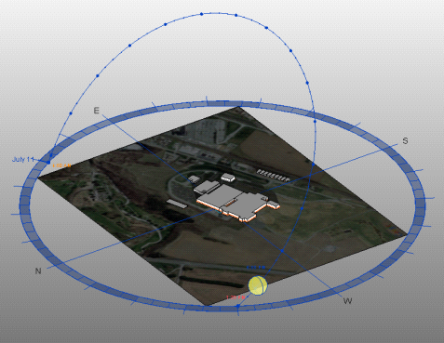
WEST FUALA PLANT EXPANSION
ENERGY ANALYSIS
JAAFAR AL AIDAROOS | CONSTRUCTION MANAGEMENT
PENN STATE AE SENIOR CAPSTONE PROJECT
ADVISOR: DR. CHIMAY ANUMBA
Solar Studies
Solar Analysis
PRESENTATION OUTLINE:
  PROJECT BACKGROUND
  ANALYSIS #1: Energy Analysis
    Information
    Energy Model
    Solar Analysis
      Solar Studies
      Ecotect Solar Radiation
      Propose Solar Design Change
      Effect on Energy model
    Recommendations
  ANALYSIS #2: Photovoltaic Array
  ANALYSIS #3: Structural Modification
  ANALYSIS #4: Bathroom Prefabrication
  LESSONS LEARNED
  ACKNOWLEDGEMENTS
Ecotect Solar Radiation
Nov 14th, 2012
July 11th, 2012

Slide 8
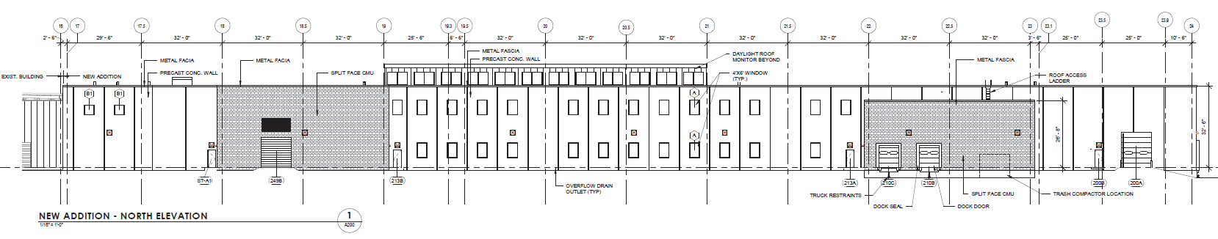
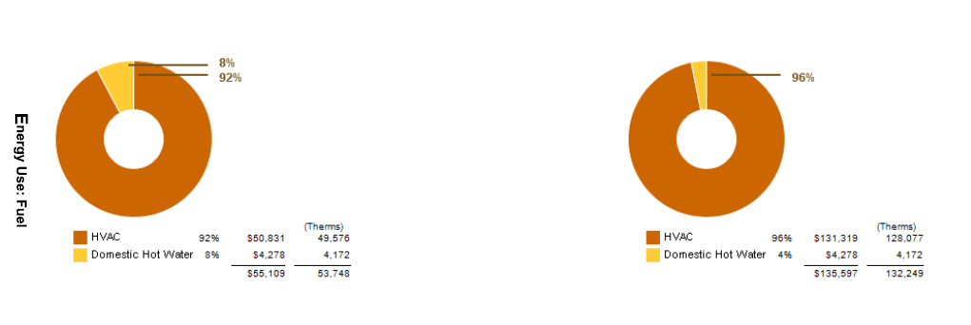
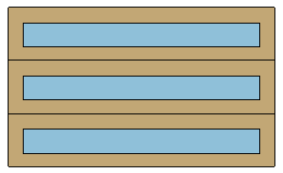
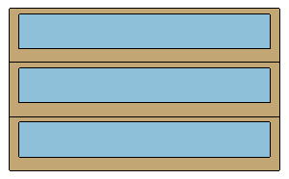
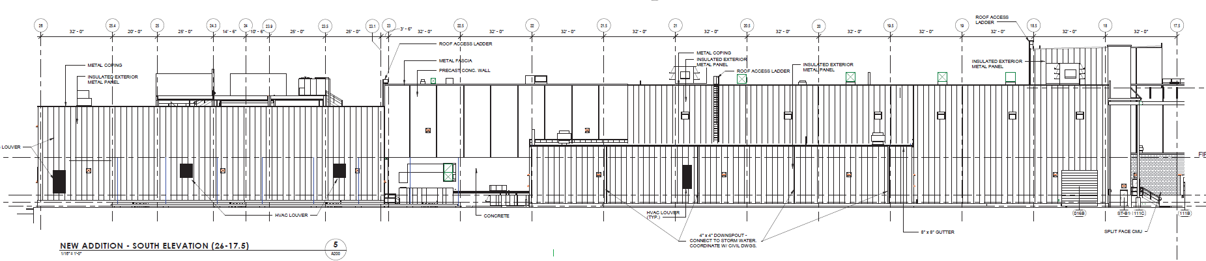
WEST FUALA PLANT EXPANSION
ENERGY ANALYSIS
JAAFAR AL AIDAROOS | CONSTRUCTION MANAGEMENT
PENN STATE AE SENIOR CAPSTONE PROJECT
ADVISOR: DR. CHIMAY ANUMBA
PRESENTATION OUTLINE:
  PROJECT BACKGROUND
  ANALYSIS #1: Energy Analysis
    Information
    Energy Model
    Solar Analysis
      Solar Studies
      Ecotect Solar Radiation
      Propose Solar Design Change
      Effect on Energy model
    Recommendations
  ANALYSIS #2: Photovoltaic Array
  ANALYSIS #3: Structural Modification
  ANALYSIS #4: Bathroom Prefabrication
  LESSONS LEARNED
  ACKNOWLEDGEMENTS
Example of design change from Solar Analysis
Proposed Design Changes:
Glazing from 20% to 40%
Energy Model Report
HVAC Cost increases from $55,000 to $131,000

Slide 9
WEST FUALA PLANT EXPANSION
ENERGY ANALYSIS
JAAFAR AL AIDAROOS | CONSTRUCTION MANAGEMENT
PENN STATE AE SENIOR CAPSTONE PROJECT
ADVISOR: DR. CHIMAY ANUMBA
PRESENTATION OUTLINE:
  PROJECT BACKGROUND
  ANALYSIS #1: Energy Analysis
    Information
    Energy Model
    Solar Analysis
      Solar Studies
      Ecotect Solar Radiation
      Propose Solar Design Change
      Effect on Energy model
    Recommendations
  ANALYSIS #2: Photovoltaic Array
  ANALYSIS #3: Structural Modification
  ANALYSIS #4: Bathroom Prefabrication
  LESSONS LEARNED
  ACKNOWLEDGEMENTS
Energy Analysis
Conclusion:
Does not affect schedule
No cost
A more sustainable long-term design
High possibility of cost reduction
Up to 25% of Energy requirements at day through lighting concepts
Recommendation:
Project Team utilize this tool to enhance and produce a more sustainable design in the long run

Slide 10
WEST FUALA PLANT EXPANSION
PHOTOVOLTAICS
JAAFAR AL AIDAROOS | CONSTRUCTION MANAGEMENT
PENN STATE AE SENIOR CAPSTONE PROJECT
ADVISOR: DR. CHIMAY ANUMBA
PRESENTATION OUTLINE:
  PROJECT BACKGROUND
  ANALYSIS #1: Energy Analysis
  ANALYSIS #2: Photovoltaic Array
    Solar Analysis
    PV systems
    Breadth:
      Electrical Systems Analysis
      Electric output of PV
    Layout
    Financial Analysis
    Recommendation
  ANALYSIS #3: Structural Modification
  ANALYSIS #4: Bathroom Prefabrication
  LESSONS LEARNED
  ACKNOWLEDGEMENTS
Incorporating Photovoltaic systems
Problem Id: High Electric energy Usage
No sustainable systems incorporated
Great potential for Renewable Energy
Proposal: Generate sustainable energy
Determine Feasibility of a PV system

Slide 11
WEST FUALA PLANT EXPANSION
PHOTOVOLTAICS
JAAFAR AL AIDAROOS | CONSTRUCTION MANAGEMENT
PENN STATE AE SENIOR CAPSTONE PROJECT
ADVISOR: DR. CHIMAY ANUMBA
PRESENTATION OUTLINE:
  PROJECT BACKGROUND
  ANALYSIS #1: Energy Analysis
  ANALYSIS #2: Photovoltaic Array
    Solar Analysis
    PV systems
    Breadth:
      Electrical Systems Analysis
      Electric output of PV
    Layout
    Financial Analysis
    Recommendation
  ANALYSIS #3: Structural Modification
  ANALYSIS #4: Bathroom Prefabrication
  LESSONS LEARNED
  ACKNOWLEDGEMENTS
Solar Analysis
Project location: Harrisburg, PA
Latitude: N 40° 22’
Longitude: W 76° 85’
Optimum Orientation: South facing side
Optimum Tilt Angle: Summer: 25°15’
Winter: 55°
(latitude ± 15°)
Sun Hours Per Day: 4.6
Solar Sky Giddied Systems | Astronergy | Sharp Grid
Array Size Ideal / Actual Watts | 19,200/17,448 | 18,800/16,944
Monthly Output | up to 2,617 kWh | up to 2,542 kWh
Number of Solar Panels | 80 panels | 80 panels
Watts | 240 | 235
Price | $37,889 | $42,110
Price Per Watt | $1.97 | $2.24

Slide 12
WEST FUALA PLANT EXPANSION
PHOTOVOLTAICS
JAAFAR AL AIDAROOS | CONSTRUCTION MANAGEMENT
PENN STATE AE SENIOR CAPSTONE PROJECT
ADVISOR: DR. CHIMAY ANUMBA
PRESENTATION OUTLINE:
  PROJECT BACKGROUND
  ANALYSIS #1: Energy Analysis
  ANALYSIS #2: Photovoltaic Array
    Solar Analysis
    PV systems
    Breadth:
      Electrical Systems Analysis
      Electric output of PV
    Layout
    Financial Analysis
    Recommendation
  ANALYSIS #3: Structural Modification
  ANALYSIS #4: Bathroom Prefabrication
  LESSONS LEARNED
  ACKNOWLEDGEMENTS
Electric Energy Output (Breadth)
Solar Sky Giddied Systems | Astronergy | Sharp Grid
Array Size Ideal / Actual Watts | 19,200/17,448 | 18,800/16,944
Monthly Output | up to 2,617 kWh | up to 2,542 kWh
Number of Solar Panels | 80 panels | 80 panels
Watts | 240 | 235
Price | $37,889 | $42,110
Price Per Watt | $1.97 | $2.24
National Renewable Energy Energy Lab
Photovoltaic system calculator
Location= Harrisburg, PA
DC Rating =174 kW Photovoltaic System
(10 sets of 80 Astronergy)
Cost of electricity = 14.3 ¢/kWh
Report:
AC Rating: 134.4 kW = 20% of Lighting System
Annual AC Energy produced: 206,937 kWh
Annual Energy Value Savings: $29,592
Lighting System Energy Usage = 650 Volt-Amperes
Photovoltaic Energy output:
1 set of 80 Astronergy = 17,448 Watts = 2.68%
10 Sets of 80 Astronergy = 174,480 Watts = 26.84 %

Slide 13
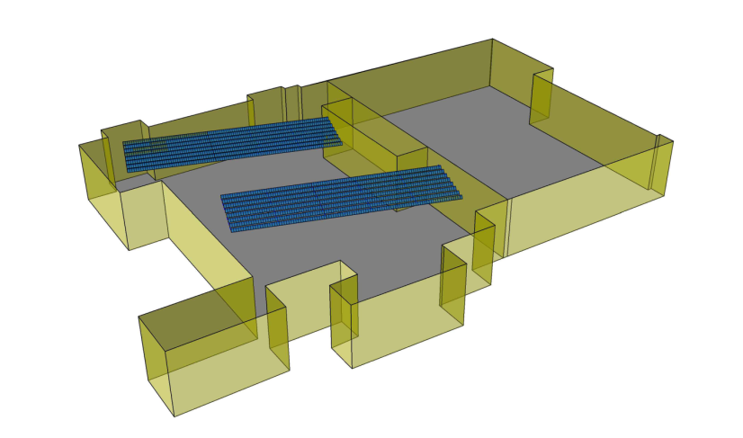
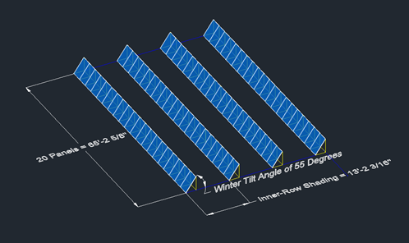
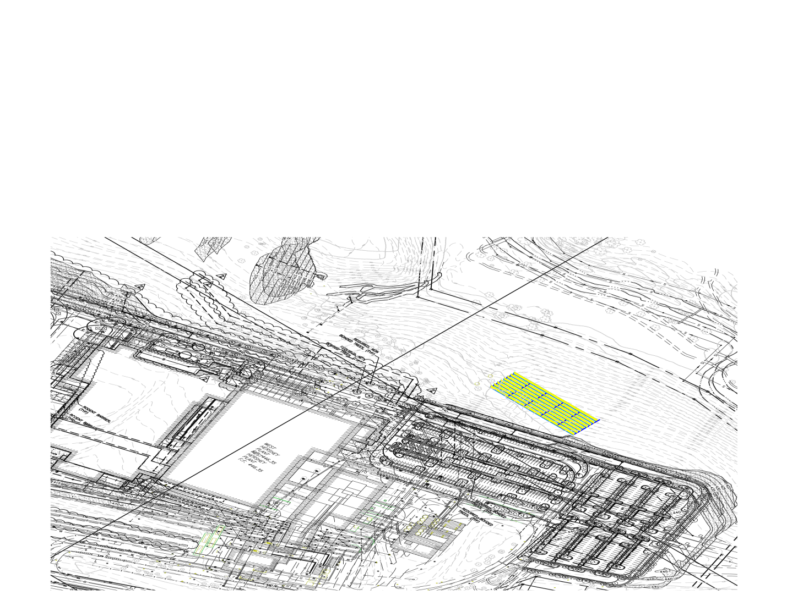
WEST FUALA PLANT EXPANSION
PHOTOVOLTAICS
JAAFAR AL AIDAROOS | CONSTRUCTION MANAGEMENT
PENN STATE AE SENIOR CAPSTONE PROJECT
ADVISOR: DR. CHIMAY ANUMBA
PRESENTATION OUTLINE:
  PROJECT BACKGROUND
  ANALYSIS #1: Energy Analysis
  ANALYSIS #2: Photovoltaic Array
    Solar Analysis
    PV systems
    Breadth:
      Electrical Systems Analysis
      Electric output of PV
    Layout
    Financial Analysis
    Recommendation
  ANALYSIS #3: Structural Modification
  ANALYSIS #4: Bathroom Prefabrication
  LESSONS LEARNED
  ACKNOWLEDGEMENTS
Layout of PV Panels
Site Layout

Slide 14
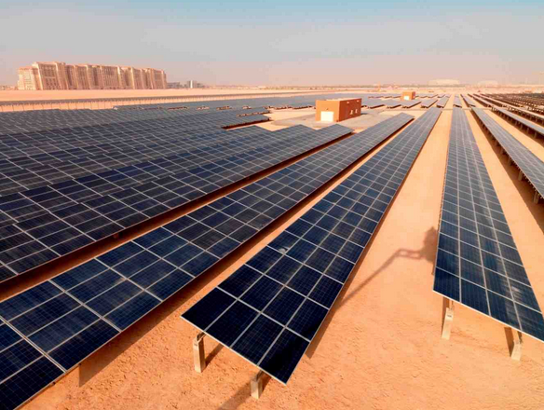
WEST FUALA PLANT EXPANSION
PHOTOVOLTAICS
JAAFAR AL AIDAROOS | CONSTRUCTION MANAGEMENT
PENN STATE AE SENIOR CAPSTONE PROJECT
ADVISOR: DR. CHIMAY ANUMBA
PRESENTATION OUTLINE:
  PROJECT BACKGROUND
  ANALYSIS #1: Energy Analysis
  ANALYSIS #2: Photovoltaic Array
    Solar Analysis
    PV systems
    Breadth:
      Electrical Systems Analysis
      Electric output of PV
    Layout
    Financial Analysis
    Recommendation
  ANALYSIS #3: Structural Modification
  ANALYSIS #4: Bathroom Prefabrication
  LESSONS LEARNED
  ACKNOWLEDGEMENTS
System Cost per Watt:
Cost of Astronergy System= $1.97 per DC watt
Gross Cost of installation = $5 per DC watt (U.S. Dept of Energy)
Financial Analysis
Solar System Calculator
Table 8.8.2: |  | Description | Monetary Values ($) | COST
Estimated System Cost |  | Assumed Installation Gross Cost |  | $8,771,723
FINANCIAL INCENTIVES |  | Pennsylvania SREC Market | $ 3,129,987
 |  | PA State SunShine Rebate | $ 52,500
 |  | Federal Tax Credit | $ 2,631,517
TOTAL SAVINGS |  |  | ($ 2,957,719)
ESTIMATED NET COST AT INSTALLATION: |  |  |  | $ 6,087,706
Cost of System = $6.97 per DC watts
Harrisburg, PA
Electric rate: $0.143/kWh
Final Price of 10 Sets of 80 Astronergy Panels = $8,771,723

Slide 15
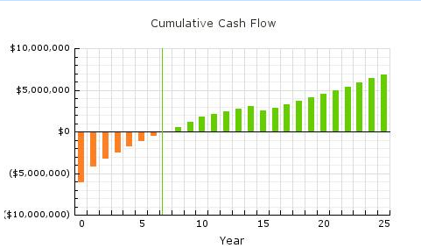
WEST FUALA PLANT EXPANSION
PHOTOVOLTAICS
JAAFAR AL AIDAROOS | CONSTRUCTION MANAGEMENT
PENN STATE AE SENIOR CAPSTONE PROJECT
ADVISOR: DR. CHIMAY ANUMBA
PRESENTATION OUTLINE:
  PROJECT BACKGROUND
  ANALYSIS #1: Energy Analysis
  ANALYSIS #2: Photovoltaic Array
    Solar Analysis
    PV systems
    Breadth:
      Electrical Systems Analysis
      Electric output of PV
    Layout
    Financial Analysis
    Recommendation
  ANALYSIS #3: Structural Modification
  ANALYSIS #4: Bathroom Prefabrication
  LESSONS LEARNED
  ACKNOWLEDGEMENTS
System Cost per Watt:
Cost of Astronergy System= $1.97 per DC watt
Gross Cost of installation = $5 per DC watt (U.S. Dept of Energy)
Financial Analysis
Solar System Calculator
Cost of System = $6.97 per DC watts
Harrisburg, PA
Electric rate: $0.143/kWh
Final Price of 10 Sets of 80 Astronergy Panels = $ 6,087,706
Payback Period = 7th Year

Slide 16
WEST FUALA PLANT EXPANSION
PHOTOVOLTAICS
JAAFAR AL AIDAROOS | CONSTRUCTION MANAGEMENT
PENN STATE AE SENIOR CAPSTONE PROJECT
ADVISOR: DR. CHIMAY ANUMBA
PRESENTATION OUTLINE:
  PROJECT BACKGROUND
  ANALYSIS #1: Energy Analysis
  ANALYSIS #2: Photovoltaic Array
    Solar Analysis
    PV systems
    Breadth:
      Electrical Systems Analysis
      Electric output of PV
    Layout
    Financial Analysis
    Recommendation
  ANALYSIS #3: Structural Modification
  ANALYSIS #4: Bathroom Prefabrication
  LESSONS LEARNED
  ACKNOWLEDGEMENTS
Final Conclusion
20% of lighting electric demand generated
$29,591 Annual Savings
Payback in 7 Years
Large available area for more Panels
Recommendations:
Owner should consider Incorporating Solar PV-Panels
Limited budget by government for incentives

Slide 17
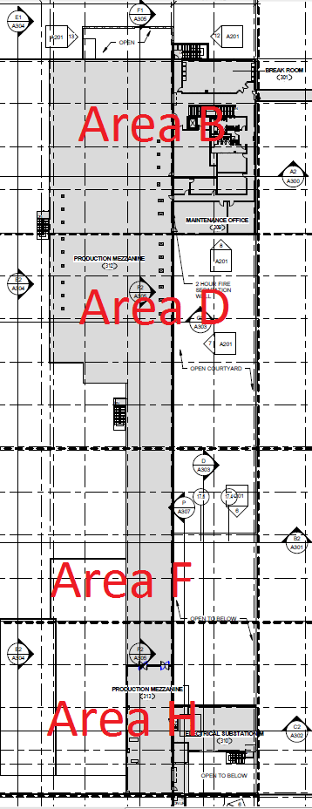
WEST FUALA PLANT EXPANSION
PRECAST CONCRETE
JAAFAR AL AIDAROOS | CONSTRUCTION MANAGEMENT
PENN STATE AE SENIOR CAPSTONE PROJECT
ADVISOR: DR. CHIMAY ANUMBA
PRESENTATION OUTLINE:
  PROJECT BACKGROUND
  ANALYSIS #1: Energy Analysis
  ANALYSIS #2: Photovoltaic Array
  ANALYSIS #3: Structural Modification
    Breadth
      Steel Loads
      Precast Concrete Loads
      Precast Concrete Column Design
    Financial
    Schedule
    Recommendation
  ANALYSIS #4: Bathroom Prefabrication
  LESSONS LEARNED
  ACKNOWLEDGEMENTS
Problem Identification:
Precast for Food plants than Steel - FDA
A lot of Precast concrete work
Mezzanine only major steel task
Many Trades
Research Proposal:
Study the viability and changes from changing Mezzanine from Steel to Precast

Slide 18
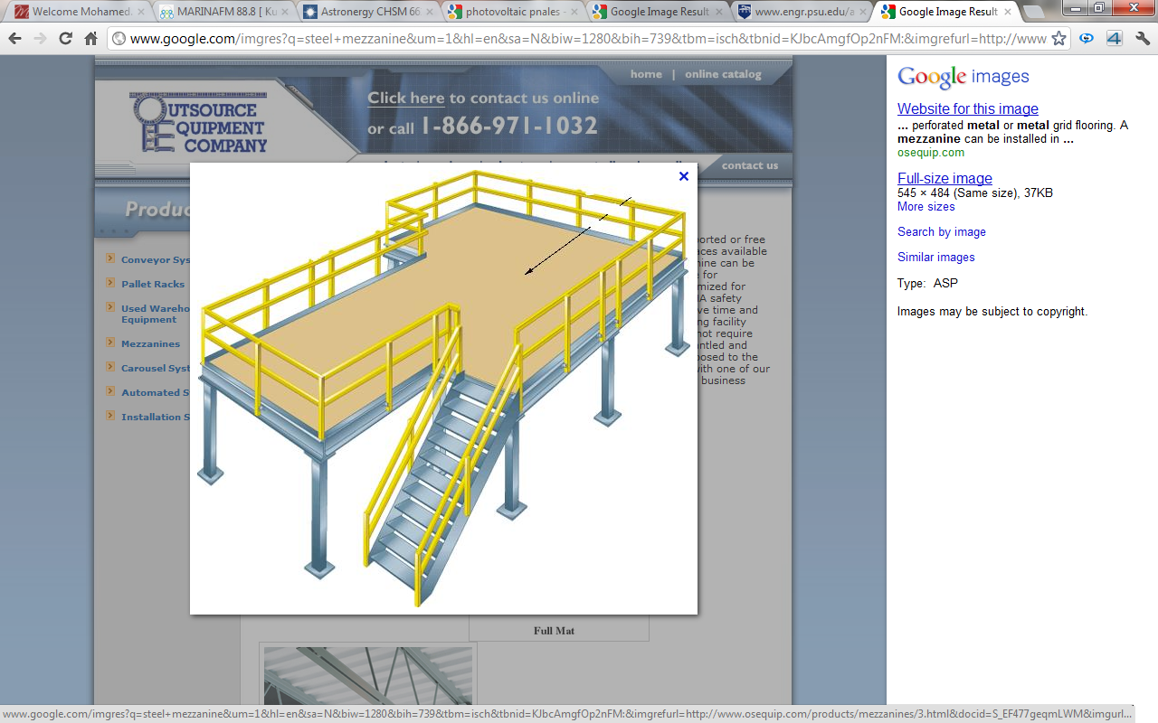
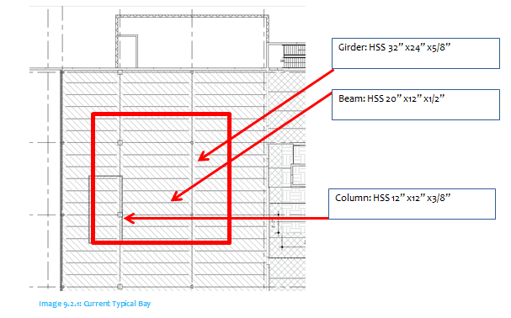
WEST FUALA PLANT EXPANSION
PRECAST CONCRETE
JAAFAR AL AIDAROOS | CONSTRUCTION MANAGEMENT
PENN STATE AE SENIOR CAPSTONE PROJECT
ADVISOR: DR. CHIMAY ANUMBA
PRESENTATION OUTLINE:
  PROJECT BACKGROUND
  ANALYSIS #1: Energy Analysis
  ANALYSIS #2: Photovoltaic Array
  ANALYSIS #3: Structural Modification
    Breadth
      Steel Loads
      Precast Concrete Loads
      Precast Concrete Column Design
    Financial
    Schedule
    Recommendation
  ANALYSIS #4: Bathroom Prefabrication
  LESSONS LEARNED
  ACKNOWLEDGEMENTS
Current Steel System

Slide 19
WEST FUALA PLANT EXPANSION
PRECAST CONCRETE
JAAFAR AL AIDAROOS | CONSTRUCTION MANAGEMENT
PENN STATE AE SENIOR CAPSTONE PROJECT
ADVISOR: DR. CHIMAY ANUMBA
Current Steel System
Breadth
Steel load Calculation
PRESENTATION OUTLINE:
  PROJECT BACKGROUND
  ANALYSIS #1: Energy Analysis
  ANALYSIS #2: Photovoltaic Array
  ANALYSIS #3: Structural Modification
    Breadth
      Steel Loads
      Precast Concrete Loads
      Precast Concrete Column Design
    Financial
    Schedule
    Recommendation
  ANALYSIS #4: Bathroom Prefabrication
  LESSONS LEARNED
  ACKNOWLEDGEMENTS
Table 9.2.1: Current System | Name | Weight | Span
Columns | HSS 12” x 12” x 3/8” | 78.52 | 17 feet
Girders | HSS 32” x 24” x 5/8” | 225.8 | 32 feet
Beams | HSS 20” x 12” x 1/2’ | 103.3 | 32 feet
Table 9.2.3 | Loads
Columns | 607 kips
Girder | 17.62 klf
Beams | 2.8 klf
6” Deck Self Weight | 90 psf

Slide 20
WEST FUALA PLANT EXPANSION
PRECAST CONCRETE
JAAFAR AL AIDAROOS | CONSTRUCTION MANAGEMENT
PENN STATE AE SENIOR CAPSTONE PROJECT
ADVISOR: DR. CHIMAY ANUMBA
PRESENTATION OUTLINE:
  PROJECT BACKGROUND
  ANALYSIS #1: Energy Analysis
  ANALYSIS #2: Photovoltaic Array
  ANALYSIS #3: Structural Modification
    Breadth
      Steel Loads
      Precast Concrete Loads
      Precast Concrete Column Design
    Financial
    Schedule
    Recommendation
  ANALYSIS #4: Bathroom Prefabrication
  LESSONS LEARNED
  ACKNOWLEDGEMENTS
Breadth Work
Precast Concrete Column Design
12”x12” HSS 20” x 20” Precast Concrete
The Column will have to have the following properties:
f’c (ksi)= 4
Fy (ksi) = 60
Tie = Rectangular Tie
8 No. 18 (US)
3 Bars in 20 in line
AS = 32 sq.in
Steel ratio = 0.08
Loads = 1730 kips
Proposed precast System Loads
Summary of loads
Column Designed can carry = 1730 kips
Required Load to be Carried = 1577 Kips
Column Design can Carry intended Load!
1730 kips > 1577 kips
Table 9.2.3 | Loads
Columns | 1577 kips
Girder | 42.56 klf
Beams | 4.3 klf
Flat Slab Self Weight | 275 psf

Slide 21
WEST FUALA PLANT EXPANSION
PRECAST CONCRETE
JAAFAR AL AIDAROOS | CONSTRUCTION MANAGEMENT
PENN STATE AE SENIOR CAPSTONE PROJECT
ADVISOR: DR. CHIMAY ANUMBA
PRESENTATION OUTLINE:
  PROJECT BACKGROUND
  ANALYSIS #1: Energy Analysis
  ANALYSIS #2: Photovoltaic Array
  ANALYSIS #3: Structural Modification
    Breadth
      Steel Loads
      Precast Concrete Loads
      Precast Concrete Column Design
    Financial
    Schedule
    Recommendation
  ANALYSIS #4: Bathroom Prefabrication
  LESSONS LEARNED
  ACKNOWLEDGEMENTS
Cost of Both Systems
(Nitterhouse concrete & RS Means)
Comparison of Systems costs
Members in a Typical Bay | Description | Cost ($) | No. of units | Total Cost ($)
Girders | HSS 32” x 24” x 5/8” | 310 /ft. | 2 | $19,840
 | 2’-0” wide x 3’-6” deep | 185 /ft. |  | $11,840
Beams | HSS 20” x 12” x 1/2’ | 201 /ft. | 7 | $45,024
 | 1’-0” wide x 2’-0” deep | 160 /ft. |  | $35,840
Slabs | Cast in Place concrete | 25 /sqft | 1 | $25,600
 | Precast Concrete slab | 20 /sqft |  | $20,480
Columns | HSS 12” x12” x 3/8” | 259 /ft. | 1 | $9,522
 | Precast Concrete 20” x 20” | 200 /ft. |  | $3,600
System | Cost of erecting a typical bay | Cost per sqft | Cost of Entire Mezzanine (32,251 SF)
Precast Concrete | $71,760 | $70.10 | $ 2,260,795.10
Steel | $99,986 | $97.64 | $ 3,148,987.64
Total Savings = $888,193 = 28.21%

Slide 22
WEST FUALA PLANT EXPANSION
PRECAST CONCRETE
JAAFAR AL AIDAROOS | CONSTRUCTION MANAGEMENT
PENN STATE AE SENIOR CAPSTONE PROJECT
ADVISOR: DR. CHIMAY ANUMBA
PRESENTATION OUTLINE:
  PROJECT BACKGROUND
  ANALYSIS #1: Energy Analysis
  ANALYSIS #2: Photovoltaic Array
  ANALYSIS #3: Structural Modification
    Breadth
      Steel Loads
      Precast Concrete Loads
      Precast Concrete Column Design
    Financial
    Schedule
    Recommendation
  ANALYSIS #4: Bathroom Prefabrication
  LESSONS LEARNED
  ACKNOWLEDGEMENTS
Schedule Analysis
Using Current Schedule and durations
Using RS Means
 | Duration for an area
Girder | 3 days
Beam | 3 days
Column | 2 days
Slab | 5 days
Member | Quantity in a typical bay | Total quantity | Daily Output | Number of days
Girders | 2 | 66 | 16 | 4.125
Beams | 7 | 231 | 24 | 9.625
Columns | 1 | 33 | 144 | 1
Slab | 3 | 99 | 18 | 5.5
13 days for an entire Area
Mezzanine is Considered 2.5 times a typical Area
32.5 days
Duration for Entire Bay:
21 days with 1 crane
11 days with 2 cranes
Erection of Envelope Phase

Slide 23
WEST FUALA PLANT EXPANSION
PRECAST CONCRETE
JAAFAR AL AIDAROOS | CONSTRUCTION MANAGEMENT
PENN STATE AE SENIOR CAPSTONE PROJECT
ADVISOR: DR. CHIMAY ANUMBA
PRESENTATION OUTLINE:
  PROJECT BACKGROUND
  ANALYSIS #1: Energy Analysis
  ANALYSIS #2: Photovoltaic Array
  ANALYSIS #3: Structural Modification
    Breadth
      Steel Loads
      Precast Concrete Loads
      Precast Concrete Column Design
    Financial
    Schedule
    Recommendation
  ANALYSIS #4: Bathroom Prefabrication
  LESSONS LEARNED
  ACKNOWLEDGEMENTS
Summary of Schedule Analysis
Steel Mezzanine Duration = 35 Days
More Realistic Approach = 32.5 Days
Minor reduction in Schedule
Schedule Analysis
Using Current Schedule and durations
Using RS Means
 | Duration for an area
Girder | 3 days
Beam | 3 days
Column | 2 days
Slab | 5 days
Member | Quantity in a typical bay | Total quantity | Daily Output | Number of days
Girders | 2 | 66 | 16 | 4.125
Beams | 7 | 231 | 24 | 9.625
Columns | 1 | 33 | 144 | 1
Slab | 3 | 99 | 18 | 5.5
13 days for an entire Area
Mezzanine is Considered 2.5 times a typical Area
32.5 days
Duration for Entire Bay:
21 days with 1 crane
11 days with 2 cranes

Slide 24
WEST FUALA PLANT EXPANSION
PRECAST CONCRETE
JAAFAR AL AIDAROOS | CONSTRUCTION MANAGEMENT
PENN STATE AE SENIOR CAPSTONE PROJECT
ADVISOR: DR. CHIMAY ANUMBA
PRESENTATION OUTLINE:
  PROJECT BACKGROUND
  ANALYSIS #1: Energy Analysis
  ANALYSIS #2: Photovoltaic Array
  ANALYSIS #3: Structural Modification
    Breadth
      Steel Loads
      Precast Concrete Loads
      Precast Concrete Column Design
    Financial
    Schedule
    Recommendation
  ANALYSIS #4: Bathroom Prefabrication
  LESSONS LEARNED
  ACKNOWLEDGEMENTS
Final Conclusion
$ 888,192.54 cost reduction
Minor Schedule Reduction
28 day Curing wait of C.I.P. concrete eliminated
Less trades on Site
Substantially Heavier structural System
Recommendations:
Owner should consider Changing Structure from Steel to Precast Concrete
Potential Cost savings and Schedule Reductions
Better design for a food plant
System | Cost of erecting a typical bay | Cost per sqft | (32,251 SF) | Duration
Precast Concrete | $71,760 | $70.10 | $ 2,260,795.10 | 32.5 Days
Steel | $99,986 | $97.64 | $ 3,148,987.64 | 35 Days

Slide 25
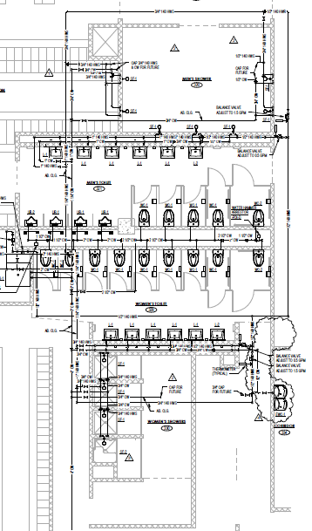
WEST FUALA PLANT EXPANSION
PREFABRICATION
JAAFAR AL AIDAROOS | CONSTRUCTION MANAGEMENT
PENN STATE AE SENIOR CAPSTONE PROJECT
ADVISOR: DR. CHIMAY ANUMBA
PRESENTATION OUTLINE:
  PROJECT BACKGROUND
  ANALYSIS #1: Energy Analysis
  ANALYSIS #2: Photovoltaic Array
  ANALYSIS #3: Structural Modification
  ANALYSIS #4: Bathroom Prefabrication
    What to Prefabricate?
    Assumptions & Parameters
      Precast concrete Wall
      On-site prefabrication & Assembly
    Logistics, Hoisting, Connecting
    Schedule & GC impact
    Recommendation
  LESSONS LEARNED
  ACKNOWLEDGEMENTS
Problem Identification:
Many Tasks taking place at the same time - Site Congestion
CMU Walls for bathrooms in Area O
A lot of Precast concrete work for Project
Research Proposal:
Determine systems that could be prefabricated
Reduce Site Congestion
Cost and Schedule Impacts

Slide 26
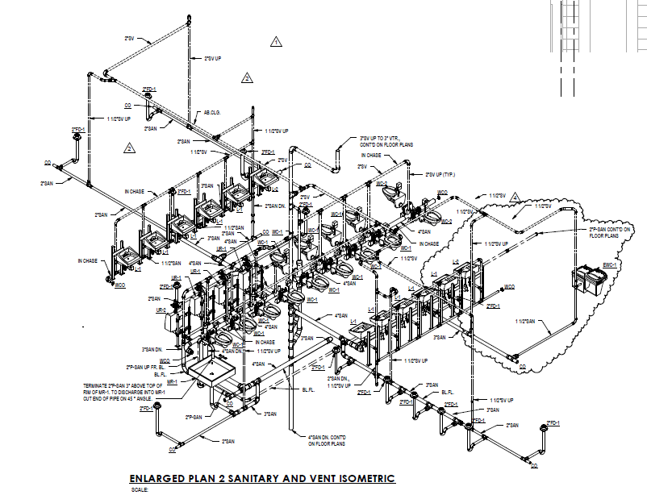
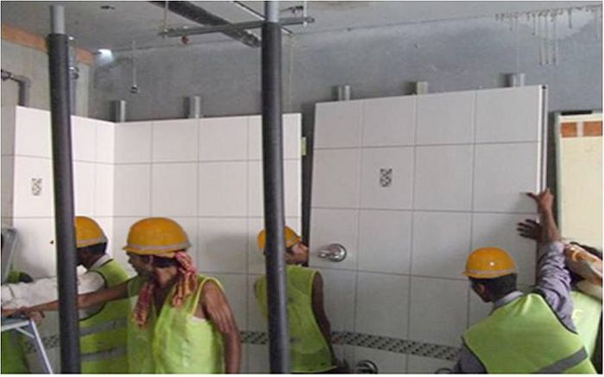
WEST FUALA PLANT EXPANSION
PREFABRICATION
JAAFAR AL AIDAROOS | CONSTRUCTION MANAGEMENT
PENN STATE AE SENIOR CAPSTONE PROJECT
ADVISOR: DR. CHIMAY ANUMBA
PRESENTATION OUTLINE:
  PROJECT BACKGROUND
  ANALYSIS #1: Energy Analysis
  ANALYSIS #2: Photovoltaic Array
  ANALYSIS #3: Structural Modification
  ANALYSIS #4: Bathroom Prefabrication
    What to Prefabricate?
    Assumptions & Parameters
      Precast concrete Wall
      On-site prefabrication & Assembly
    Logistics, Hoisting, Connecting
    Schedule & GC impact
    Recommendation
  LESSONS LEARNED
  ACKNOWLEDGEMENTS
What to Prefabricate?
What will be Prefabricated:
Bathroom Walls as precast concrete with Piping and electric rough-ins
Bathroom finishes Prefabrication

Slide 27
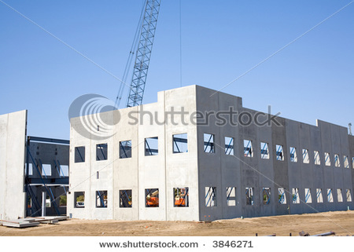
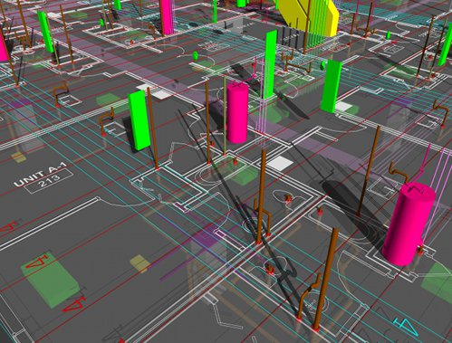
WEST FUALA PLANT EXPANSION
PREFABRICATION
JAAFAR AL AIDAROOS | CONSTRUCTION MANAGEMENT
PENN STATE AE SENIOR CAPSTONE PROJECT
ADVISOR: DR. CHIMAY ANUMBA
PRESENTATION OUTLINE:
  PROJECT BACKGROUND
  ANALYSIS #1: Energy Analysis
  ANALYSIS #2: Photovoltaic Array
  ANALYSIS #3: Structural Modification
  ANALYSIS #4: Bathroom Prefabrication
    What to Prefabricate?
    Assumptions & Parameters
      Precast concrete Wall
      On-site prefabrication & Assembly
    Logistics, Hoisting, Connecting
    Schedule & GC impact
    Recommendation
  LESSONS LEARNED
  ACKNOWLEDGEMENTS
Precast Concrete Bathroom prefabrication
Assumptions for proposed precast walls:
The same methods used for the current precast concrete envelope would be used for the precast bathroom walls:
Procurement
Prefabrication
Transportation
Hoisting
Connecting

Slide 28
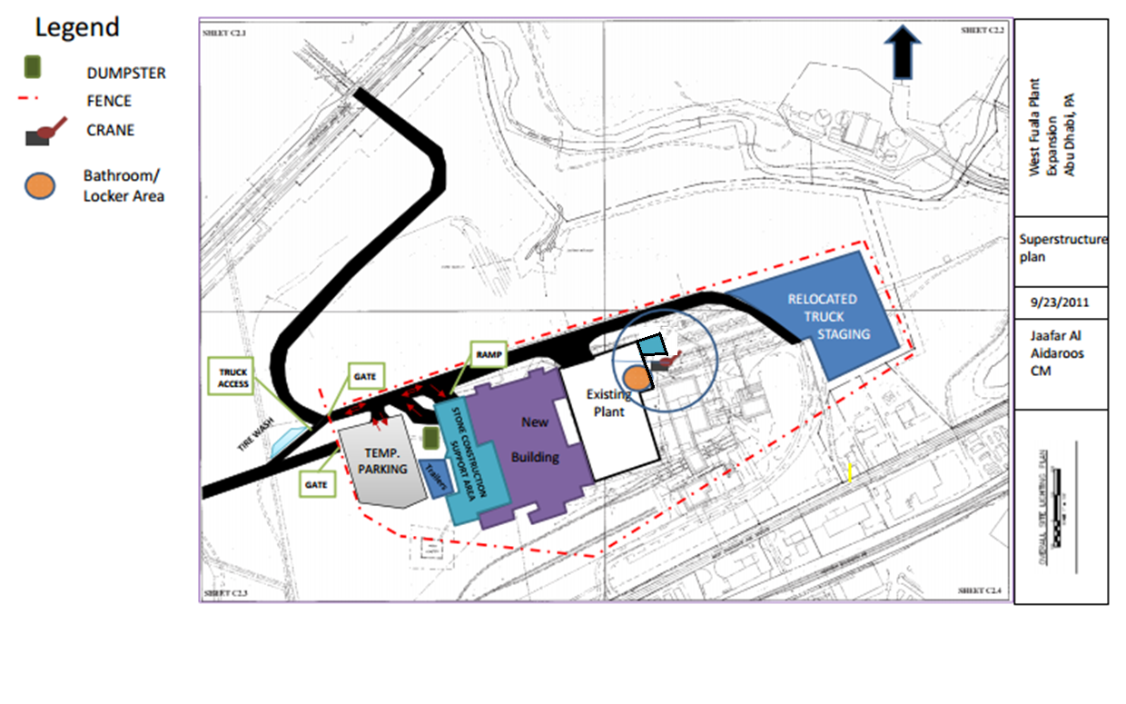
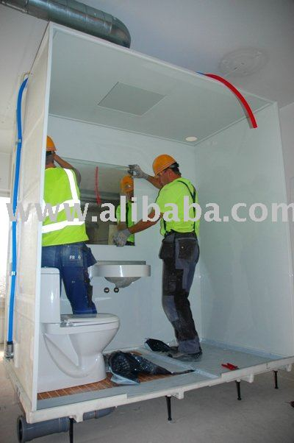
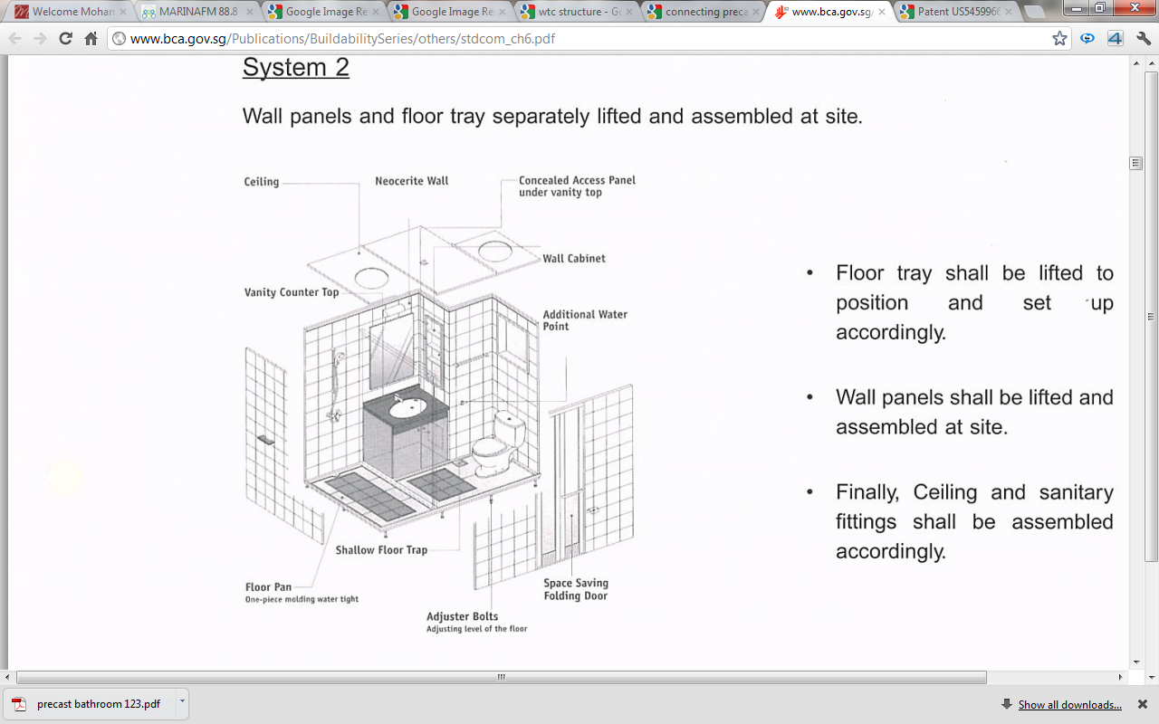
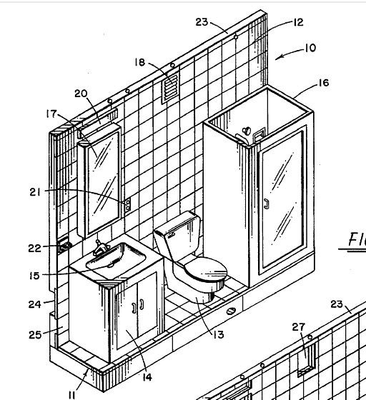
WEST FUALA PLANT EXPANSION
PREFABRICATION
JAAFAR AL AIDAROOS | CONSTRUCTION MANAGEMENT
PENN STATE AE SENIOR CAPSTONE PROJECT
ADVISOR: DR. CHIMAY ANUMBA
PRESENTATION OUTLINE:
  PROJECT BACKGROUND
  ANALYSIS #1: Energy Analysis
  ANALYSIS #2: Photovoltaic Array
  ANALYSIS #3: Structural Modification
  ANALYSIS #4: Bathroom Prefabrication
    What to Prefabricate?
    Assumptions & Parameters
      Precast concrete Wall
      On-site prefabrication & Assembly
    Logistics, Hoisting, Connecting
    Schedule & GC impact
    Recommendation
  LESSONS LEARNED
  ACKNOWLEDGEMENTS
On-Site Prefabrication
Walls and finishes assembled at site and then hoisted into place
Bathroom Finishings:
Toilet Paper Dispenser
Paper Towel Dispenser
Sanitary Napkin Disposal
24”x26” mirror
Soap dispenser
Site Logistics

Slide 29
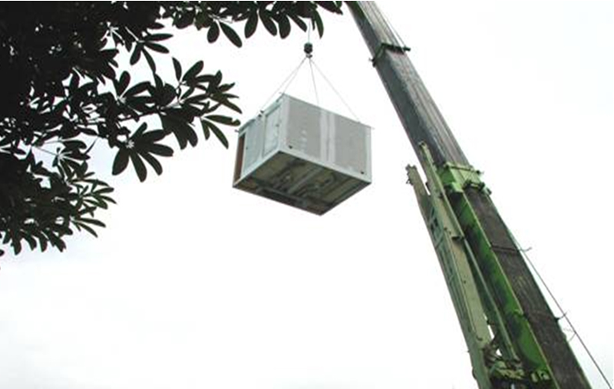
WEST FUALA PLANT EXPANSION
PREFABRICATION
JAAFAR AL AIDAROOS | CONSTRUCTION MANAGEMENT
PENN STATE AE SENIOR CAPSTONE PROJECT
ADVISOR: DR. CHIMAY ANUMBA
PRESENTATION OUTLINE:
  PROJECT BACKGROUND
  ANALYSIS #1: Energy Analysis
  ANALYSIS #2: Photovoltaic Array
  ANALYSIS #3: Structural Modification
  ANALYSIS #4: Bathroom Prefabrication
    What to Prefabricate?
    Assumptions & Parameters
      Precast concrete Wall
      On-site prefabrication & Assembly
    Logistics, Hoisting, Connecting
    Schedule & GC impact
    Recommendation
  LESSONS LEARNED
  ACKNOWLEDGEMENTS
Site Logistics
Bathroom Finishings:
Toilet Paper Dispenser
Paper Towel Dispenser
Sanitary Napkin Disposal
24”x26” mirror
Soap dispenser
Hoisting Prefabricated units

Slide 30
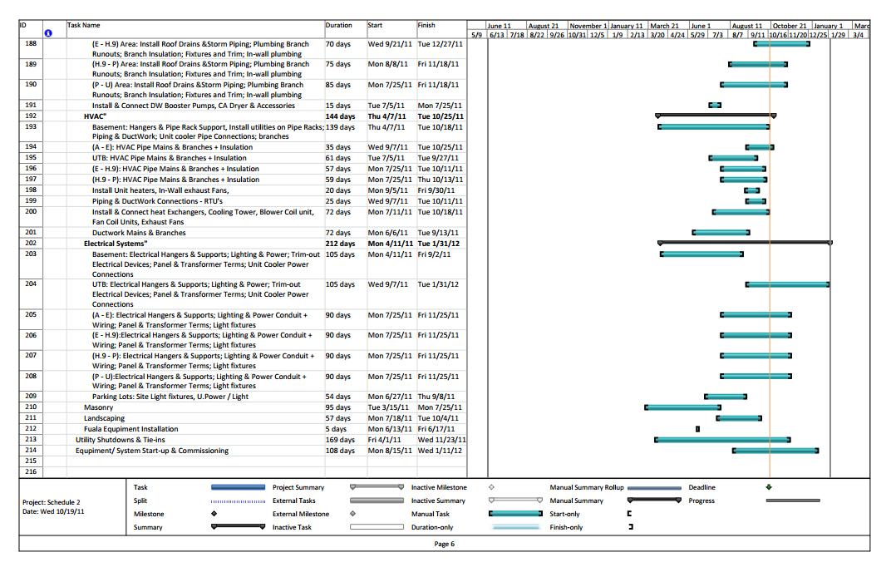
WEST FUALA PLANT EXPANSION
PREFABRICATION
JAAFAR AL AIDAROOS | CONSTRUCTION MANAGEMENT
PENN STATE AE SENIOR CAPSTONE PROJECT
ADVISOR: DR. CHIMAY ANUMBA
PRESENTATION OUTLINE:
  PROJECT BACKGROUND
  ANALYSIS #1: Energy Analysis
  ANALYSIS #2: Photovoltaic Array
  ANALYSIS #3: Structural Modification
  ANALYSIS #4: Bathroom Prefabrication
    What to Prefabricate?
    Assumptions & Parameters
      Precast concrete Wall
      On-site prefabrication & Assembly
    Logistics, Hoisting, Connecting
    Schedule & GC impact
    Recommendation
  LESSONS LEARNED
  ACKNOWLEDGEMENTS
Current Schedule
Critical Path task
Schedule impact:
General Conditions Impact
  GC Calculated to be $992,000 over 22 Months
  Around 43 Days of Project Schedule Saving = $67,500 of GC Savings
Task | Early Start | Early Finish
Install Masonry Walls | 22 Jun | 07 Sept
In-Wall plumbing | 24 Jun | 19 July
In-Wall Electric Rough-in | 27 Jun | 07 Sept
HVAC Main Duct Work | 01 July | 07 Sept
Plumbing Insulation | 06 July | 07 Sept
Piping and ductwork connections | 25 July | 07 Sept
Current Duration: 45 days of construction for CMU walls
Using RS Means & actual Project Schedule
Proposed system Duration:
2 days for hoisting precast walls

Slide 31
WEST FUALA PLANT EXPANSION
PREFABRICATION
JAAFAR AL AIDAROOS | CONSTRUCTION MANAGEMENT
PENN STATE AE SENIOR CAPSTONE PROJECT
ADVISOR: DR. CHIMAY ANUMBA
PRESENTATION OUTLINE:
  PROJECT BACKGROUND
  ANALYSIS #1: Energy Analysis
  ANALYSIS #2: Photovoltaic Array
  ANALYSIS #3: Structural Modification
  ANALYSIS #4: Bathroom Prefabrication
    What to Prefabricate?
    Assumptions & Parameters
      Precast concrete Wall
      On-site prefabrication & Assembly
    Logistics, Hoisting, Connecting
    Schedule & GC impact
    Recommendation
  LESSONS LEARNED
  ACKNOWLEDGEMENTS
Final Conclusion of prefabrication
  43 Days of Schedule Reduction
  $62.5K Worth of GC Savings
  Major Reduction in site congestions
  Increased Safety, Quality
  Less Waste
Recommendation
  Pursue Prefabrication of Bathrooms in Area O
  Met goals of reducing site congestions

Slide 32
WEST FUALA PLANT EXPANSION
LESSONS LEARNED
JAAFAR AL AIDAROOS | CONSTRUCTION MANAGEMENT
PENN STATE AE SENIOR CAPSTONE PROJECT
ADVISOR: DR. CHIMAY ANUMBA
PRESENTATION OUTLINE:
  PROJECT BACKGROUND
  ANALYSIS #1: Energy Analysis
  ANALYSIS #2: Photovoltaic Array
  ANALYSIS #3: Structural Modification
  ANALYSIS #4: Bathroom
  LESSONS LEARNED
  ACKNOWLEDGEMENTS
Lessons learned
Analysis 1: Energy Model
No cost to produce a design with less energy usage
Analysis 2: Photovoltaic Panels
Sustainable Energy with a 7 year payback period
Analysis 3: Structure modification
Reduction in Schedule and Cost
Analysis 4: Bathroom prefabrication
Many Advantages: reduced Congestion, schedule, safety, quality

Slide 33



WEST FUALA PLANT EXPANSION
ACKNOWLEDGEMENT
JAAFAR AL AIDAROOS | CONSTRUCTION MANAGEMENT
PENN STATE AE SENIOR CAPSTONE PROJECT
ADVISOR: DR. CHIMAY ANUMBA
PRESENTATION OUTLINE:
  PROJECT BACKGROUND
  ANALYSIS #1: Energy Analysis
  ANALYSIS #2: Photovoltaic Array
  ANALYSIS #3: Structural Modification
  ANALYSIS #4: Bathroom Prefabrication
  LESSONS LEARNED
  ACKNOWLEDGEMENTS
Pennsylvania State University
AE Department
Dr. Moses Ling Dr. Chimay Anumba
United Arab Emirates
H.H. Sheikh Khalifa Bin Zayed
Mrs Abir Khater
Family
Friends
AE Classmates
Turner Construction Company

Slide 34
WEST FUALA PLANT EXPANSION
ENERGY ANALYSIS
JAAFAR AL AIDAROOS | CONSTRUCTION MANAGEMENT
PENN STATE AE SENIOR CAPSTONE PROJECT
ADVISOR: DR. CHIMAY ANUMBA
Financial
Thank You!
Questions?

Slide 35
WEST FUALA PLANT EXPANSION
PHOTOVOLTAICS
JAAFAR AL AIDAROOS | CONSTRUCTION MANAGEMENT
PENN STATE AE SENIOR CAPSTONE PROJECT
ADVISOR: DR. CHIMAY ANUMBA
Financial
Electric Loads & Layout
Summary of Calculations
System Covers 20% of the lighting system
Annual Savings of $29,591 on Electric Bill
Power Factor = 1.0 of Lighting system
134 kW / 650 kW = 20.615%
Photovoltaic Panels
System Cost per Watt:
Cost of Astronergy System= $1.97 per DC watt
Gross Cost of installation = $5 per DC watt (U.S. Dept of Energy)
Table 8.8.2: |  | Description | Monetary Values ($) | COST
Estimated System Cost |  | Assumed Installation Gross Cost |  | $8,771,723
FINANCIAL INCENTIVES |  | Pennsylvania SREC Market | $ 3,129,987
 |  | PA State SunShine Rebate | $ 52,500
 |  | Federal Tax Credit | $ 2,631,517
TOTAL SAVINGS |  |  | ($ 2,957,719)
ESTIMATED NET COST AT INSTALLATION: |  |  |  | $ 6,087,706
PENN STATE AE SENIOR CAPSTONE PROJECT
JAAFAR AL AIDAROOS| CONSTRUCTION MANAGEMENT
ADVISOR: DR. CHIMAY ANUMBA

Slide 36
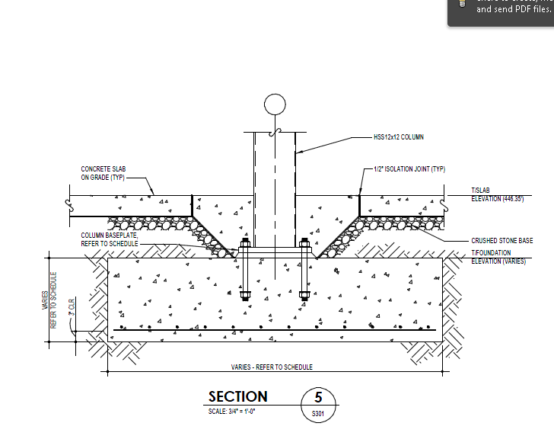
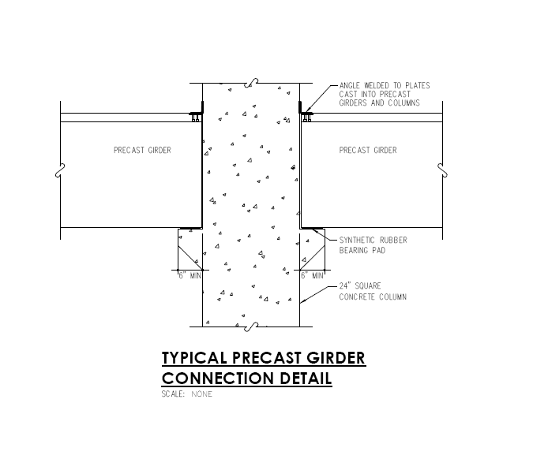
WEST FUALA PLANT EXPANSION
PRECAST CONCRETE
JAAFAR AL AIDAROOS | CONSTRUCTION MANAGEMENT
PENN STATE AE SENIOR CAPSTONE PROJECT
ADVISOR: DR. CHIMAY ANUMBA
Breadth
Steel load Calculation
HSS 12x12Column
Concrete S.O.G.
Changing the Structure of the Mezzanine
Assumptions and parameters
Process equipment penetration were not known, so structure was switched to steel to prevent delay
There is enough space for minor design modification
Typical Bay method fro calculations
Maintain original design of mezzanine
Typical Bay | Description | Cost ($) | No. units | Total Cost | Loads
Girders | HSS 32” x 24” x 5/8” | 310 /ft. | 2 | $19,840 | 17.62 klf
 | 2’-0” wide x 3’-6” deep | 185 /ft. |  | $11,840 | 42.56 klf
Beams | HSS 20” x 12” x 1/2’ | 201 /ft. | 7 | $45,024 | 2.8 klf
 | 1’-0” wide x 2’-0” deep | 160 /ft. |  | $35,840 | 4.3 klf
Slabs | CIP concrete | 25 /sqft | 1 | $25,600 | 90 psf
 | Precast slab | 20 /sqft |  | $20,480 | 275 psf
Columns | HSS 12” x12” x 3/8” | 259 /ft. | 1 | $9,522 | 607 kips
 | Precast Concrete 20” x 20” | 200 /ft. |  | $3,600 | 1577 kips
System | Cost of erecting a typical bay | Cost per sqft | (32,251 SF) | Duration
Precast Concrete | $71,760 | $70.10 | $ 2,260,795.10 | 35 Days
Steel | $99,986 | $97.64 | $ 3,148,987.64 | 32.5 Days
PENN STATE AE SENIOR CAPSTONE PROJECT
JAAFAR AL AIDAROOS| CONSTRUCTION MANAGEMENT
ADVISOR: DR. CHIMAY ANUMBA

Slide 37
WEST FUALA PLANT EXPANSION
PRECAST CONCRETE
JAAFAR AL AIDAROOS | CONSTRUCTION MANAGEMENT
PENN STATE AE SENIOR CAPSTONE PROJECT
ADVISOR: DR. CHIMAY ANUMBA
Breadth
Steel load Calculation
Breadth Work
Precast Concrete Column Design
12”x12” HSS 20” x 20” Precast Concrete
The Column will have to have the following properties:
AS = 32 sq.in
Steel ratio = 0.08
f’c (ksi)= 4 x 0.92 = 3.68
Fy (ksi) = 60 x 0.08 = 4.8
Total = 8.48 x 17 ft x 12in/ft) = 1729.92 kips
8 No. 18 (US)
Changing the Structure of the Mezzanine
Assumptions and parameters
Process equipment penetration were not known, so structure was switched to steel to prevent delay
There is enough space for minor design modification
Typical Bay method fro calculations
Maintain original design of mezzanine
Typical Bay | Description | Cost ($) | No. units | Total Cost | Loads
Girders | HSS 32” x 24” x 5/8” | 310 /ft. | 2 | $19,840 | 17.62 klf
 | 2’-0” wide x 3’-6” deep | 185 /ft. |  | $11,840 | 42.56 klf
Beams | HSS 20” x 12” x 1/2’ | 201 /ft. | 7 | $45,024 | 2.8 klf
 | 1’-0” wide x 2’-0” deep | 160 /ft. |  | $35,840 | 4.3 klf
Slabs | CIP concrete | 25 /sqft | 1 | $25,600 | 90 psf
 | Precast slab | 20 /sqft |  | $20,480 | 275 psf
Columns | HSS 12” x12” x 3/8” | 259 /ft. | 1 | $9,522 | 607 kips
 | Precast Concrete 20” x 20” | 200 /ft. |  | $3,600 | 1577 kips
System | Cost of erecting a typical bay | Cost per sqft | (32,251 SF) | Duration
Precast Concrete | $71,760 | $70.10 | $ 2,260,795.10 | 35 Days
Steel | $99,986 | $97.64 | $ 3,148,987.64 | 32.5 Days
PENN STATE AE SENIOR CAPSTONE PROJECT
JAAFAR AL AIDAROOS| CONSTRUCTION MANAGEMENT
ADVISOR: DR. CHIMAY ANUMBA

Slide 38
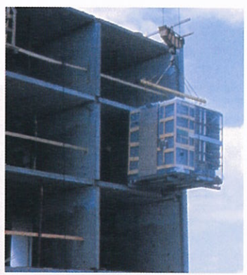
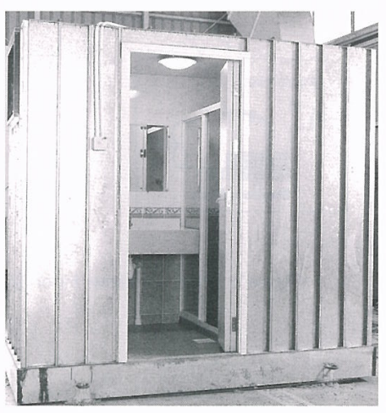
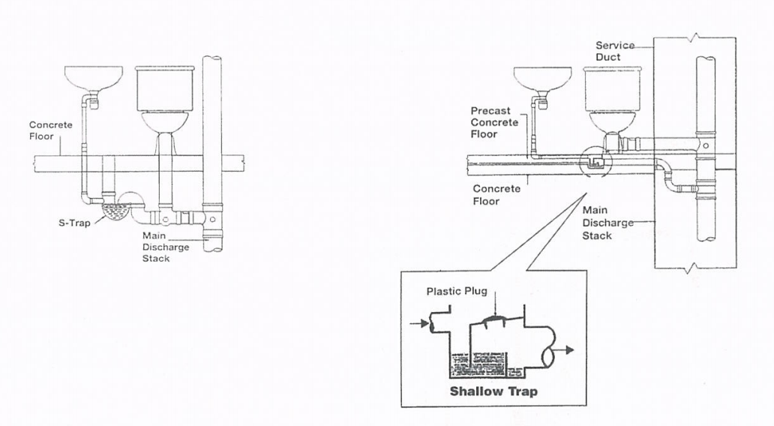
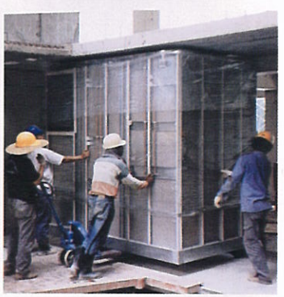
WEST FUALA PLANT EXPANSION
PREFABRICATION
JAAFAR AL AIDAROOS | CONSTRUCTION MANAGEMENT
PENN STATE AE SENIOR CAPSTONE PROJECT
ADVISOR: DR. CHIMAY ANUMBA
Finishes installed to walls on site and then hoisted into place
Finishes and wall preassembled in factory. Delivered and hoisted
Contingency pipes should be cast in structural Slabs as an outlet pipe for seepage
Electrical service shall also be connected to the main switch
Gap in the between bathroom and structural slab will be packed with non-shrink grout around perimeters
PENN STATE AE SENIOR CAPSTONE PROJECT
JAAFAR AL AIDAROOS| CONSTRUCTION MANAGEMENT
ADVISOR: DR. CHIMAY ANUMBA

Slide 39
WEST FUALA PLANT EXPANSION
JAAFAR AL AIDAROOS | CONSTRUCTION MANAGEMENT
PENN STATE AE SENIOR CAPSTONE PROJECT
ADVISOR: DR. CHIMAY ANUMBA
PRESENTATION OUTLINE:
  PROJECT BACKGROUND
  ANALYSIS #1: Energy Analysis
    Conceptual Design
    Energy Model
    Solar Analaysis
      Solar Studies
      Ecotect Solar Radiation
    Application to Energy Model
    Recommendations
  ANALYSIS #2: Photovoltaic Array
    Electrical Systems Analysis
    Solar Analysis
    PV systems
    Layout
    Electrical Energy production
    Financial Analysis
    Recommendation
West Fuala Plant Expansion
Abu Dhabi, PA
Breadth
Steel load Calculation
Bathroom Prefabrication
PENN STATE AE SENIOR CAPSTONE PROJECT
JAAFAR AL AIDAROOS| CONSTRUCTION MANAGEMENT
ADVISOR: DR. CHIMAY ANUMBA

